Slide 1
Data Analytics with Python

Slide 2
Some Special Distributions
Discrete
Binomial
Poisson
Hyper geometric
Continuous
Uniform
Exponential
Normal

Slide 3
Binomial Distribution
Let us consider the purchase decisions of the next three customers who enter a store.
On the basis of past experience, the store manager estimates the probability that any one customer will make a purchase is .30.
What is the probability that two of the next three customers will make a
purchase?

Slide 4
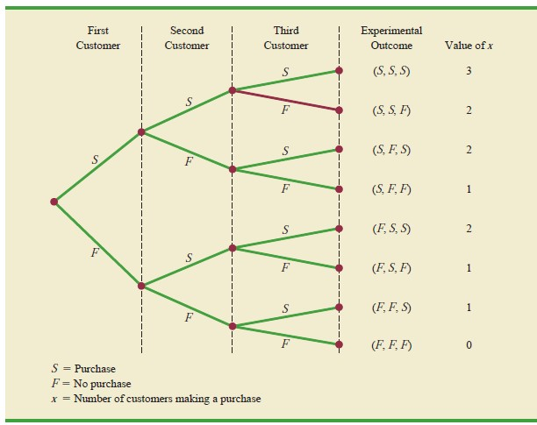
Tree diagram for the Martin clothing store problem

Slide 5
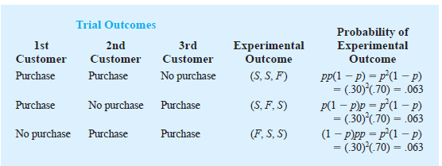
Trial Outcomes

Slide 6
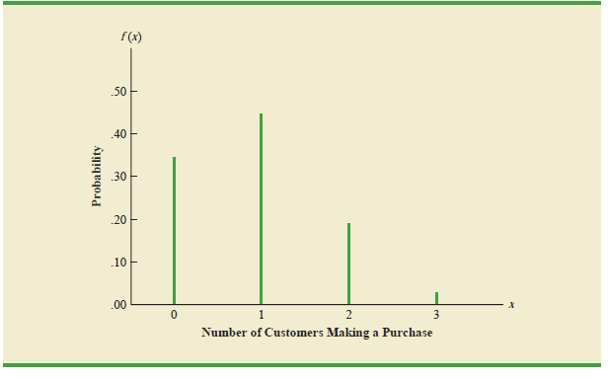
Graphical representation of the probability distribution for the number of customers making a purchase
x | P(x)
0 | 0.7 x 0.7 x 0.7=0.343
1 | 0.3x0.7x07+ 0.7x0.3x0.7+ 0.7x0.7x0.3 = 0.441
2 | 0.189
3 | 0.027

Slide 7
Binomial Distribution- Assumtions
Experiment involves n identical trials
Each trial has exactly two possible outcomes: success and failure
Each trial is independent of the previous trials
p is the probability of a success on any one trial
q = (1-p) is the probability of a failure on any one trial
p and q are constant throughout the experiment
X is the number of successes in the n trials

Slide 8
Binomial Distribution
_{p}X _{⋅ q}n− X
Probability function
n!
X !(n − X )!
P(X ) =
for 0 ≤ X ≤ n
Mean value
μ = n ⋅ p
Variance and standard deviation
σ² = n ⋅ p ⋅ q
_{σ}2 ₌
σ =
n ⋅ p ⋅ q

Slide 9
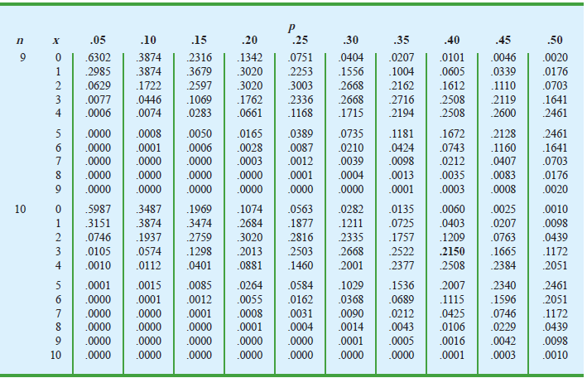
Binomial Table
SELECTED VALUES FROM THE BINOMIAL PROBABILITY TABLE EXAMPLE: n = 10, x = 3, p = .40; f (3) = .2150

Slide 10

Mean and Variance
Suppose that for the next month the Clothing Store forecasts 1000 customers will enter the store.
What is the expected number of customers who will make a purchase?
The answer is μ = np = (1000)(.3) = 300.
For the next 1000 customers entering the store, the variance and standard deviation for the number of customers who will make a purchase are

Slide 11
Poisson Distribution
Describes discrete occurrences over a continuum or interval
A discrete distribution
Describes rare events
Each occurrence is independent any other occurrences.
The number of occurrences in each interval can vary from zero to infinity.
The expected number of occurrences must hold constant throughout the experiment.

Slide 12
Poisson Distribution: Applications
Arrivals at queuing systems
airports -- people, airplanes, automobiles, baggage
banks -- people, automobiles, loan applications
computer file servers -- read and write operations
Defects in manufactured goods
number of defects per 1,000 feet of extruded copper wire
number of blemishes per square foot of painted surface
number of errors per typed page

Slide 13
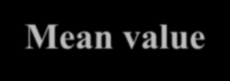


Poisson Distribution
Probability function
_{λ}X _{e}−λ
P( X ) =
where:
for X = 0,1, 2, 3,...
X !
λ = long − run average
e = 2. 718282... (the base of natural logarithms )
Mean value
Variance Standard deviation
 | λ |  | λ
λ

Slide 14
Poisson Distribution: Example
λ = 3.2 customers/4 minutes X = 10 customers/8 minutes Adjusted λ
λ=6.4 customers/8 minutes
λ = 3.2 customers/4 minutes X = 6 customers/8 minutes Adjusted λ
λ=6.4 customers/8 minutes
_{λ} X_{e}−λ
X !
_{λ} X_{e}−λ
X !
P(X)=
P(X)=
_{6.4}10_{e}−6.4
10!
_{6.4}6_{e}−6.4
6!
P(X =10)=
= 0.0528
P(X =6)=
= 0.1586

Slide 15
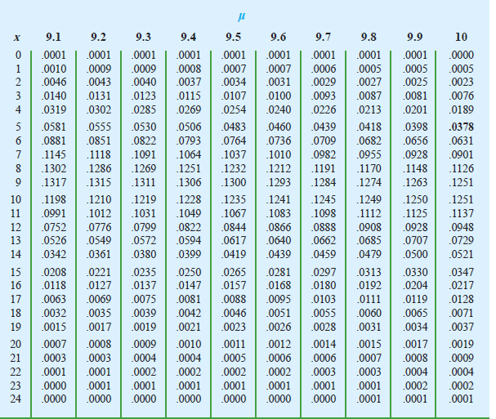
Poisson Probability Table Example: μ = 10, x = 5; f (5) = .0378

Slide 16
The Hypergeometric Distribution
The binomial distribution is applicable when selecting from a finite population with replacement or from an infinite population without replacement.
The hypergeometric distribution is applicable when selecting
from a finite population without replacement.

Slide 17
Hyper Geometric Distribution
Sampling without replacement from a finite population
The number of objects in the population is denoted N.
Each trial has exactly two possible outcomes, success and failure.
Trials are not independent
X is the number of successes in the n trials
The binomial is an acceptable approximation, if N/10 > n Otherwise it is not.

Slide 18
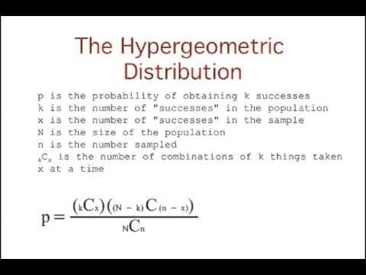

Slide 19
The Hypergeometric Distribution Example
Different computers are checked from 10 in the department. 4 of the 10
computers have illegal software loaded.
What is the probability that 2 of the 3 selected computers have illegal software loaded?
So, N = 10, n = 3, k = 4, X = 2
⎛ k ⎞⎛N − k ⎞ ⎛ 4⎞⎛ 6⎞
⎜ ⎟⎜ ⎟ ⎜ ⎟⎜ ⎟
⎜ _{X}⎟⎜_{n − X} ⎟ ⎜ ₂ ⎟⎜₁ ⎟
(6)(6)
P(X = 2) = ⎝ ⎠⎝ ⎠ = ⎝ ⎠⎝ ⎠ =
= 0.3
⎛N⎞
⎛10⎞
120
⎜ ⎟
⎜ ⎟
⎜_{n} ⎟
⎜₃ ⎟
⎝ ⎠ ⎝ ⎠
The probability that 2 of the 3 selected computers have illegal software loaded is .30, or 30%.

Slide 20
Continuous Probability Distributions
A continuous random variable is a variable that can assume any value on a continuum (can assume an uncountable number of values)
thickness of an item
time required to complete a task
temperature of a solution
height
These can potentially take on any value, depending only on the ability to measure precisely and accurately.

Slide 21
Continuous Distributions
Uniform
Normal
Exponential

Slide 22
The Uniform Distribution
The uniform distribution is a probability distribution that has equal
probabilities for all possible outcomes of the random variable
Because of its shape it is also called a rectangular distribution

Slide 23
Uniform Distribution
⎧ 1
for
a ≤ x ≤ b
⎪b − a
1
b − a
f (x) = ⎪
⎨
⎪
⎩
0
for all other values
f (x)
Area = 1
a
x
b

Slide 24
Uniform Distribution: Mean and Standard Deviation
Mean
a + b
2
μ =
Standard Deviation
_{σ =} b − a
12

Slide 25
The Uniform Distribution
Example: Uniform probability distribution over the range
2 ≤ X ≤ 6:
f(X) = ¹ = .25
for 2 ≤ X ≤ 6
6 - 2
f(X)
.25
_{μ =} a + b ₌ 2 + 6 ₌ ₄ 2 2
(b - a) ²
12
(6 - 2) ²
12
X
σ =
=
= 1 .1547
2
6

Slide 26
Uniform Distribution Example
⎧ 1
for 41 ≤ x ≤ 47
⎪47 − 41
1 ₌ 47 − 41
 | Area = 1
1
6
f ( x) = ⎨
⎪ 0
for all other values
f ( x)
⎩
41
47 x

Slide 27
Uniform Distribution: Mean and Standard Deviation
Mean
Mean
a + b _{μ =} 41+47 ₌ 88 ₌ ₄₄
2 2 2
μ =
Standard Deviation
_{σ =} b − a
12
Standard Deviation
_{σ =} 47 − 41 ₌ 6
12 3. 464
= 1. 732

Slide 28
Uniform Distribution Probability
x
x
x x
P( ≤ X ≤
) =
2
1
1
2
b − a
45 − 42 ₌ 47 − 41
 |  | Area = 0.5
1
2
f (x)
P(42 ≤ X ≤ 45) = ⁴⁵ ⁻ ⁴² = ¹
47 − 41 2
41
47 x

Slide 29
Example : Uniform Distribution
Consider the random variable x representing the flight time of an airplane
traveling from Delhi to Mumbai.
Suppose the flight time can be any value in the interval from 120 minutes
to 140 minutes.
Because the random variable x can assume any value in that interval, x is a continuous rather than a discrete random variable
29

Slide 30
Example : Uniform Distribution contd….
Let us assume that sufficient actual flight data are available to conclude that the probability of a flight time within any 1-minute interval is the same as the probability of a flight time within any other 1-minute interval contained in the larger interval from 120 to 140 minutes.
With every 1-minute interval being equally likely, the random variable x is
said to have a uniform probability distribution.
30

Slide 31
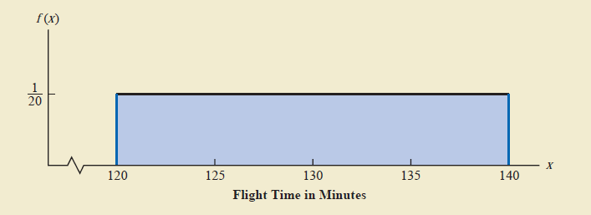
Uniform Probability Distribution for Flight time
31

Slide 32
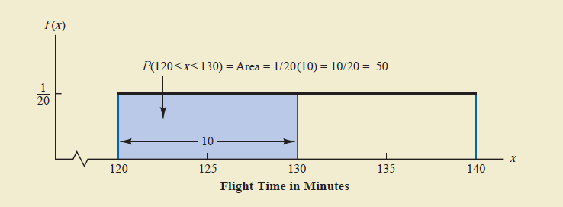
Probability of a flight time between 120 and 130 minutes
32

Slide 33



Exponential Probability Distribution
The exponential probability distribution is useful in describing the time it
takes to complete a task.
The exponential random variables can be used to describe:
Time required
to complete
a questionnaire
Distance between major defects in a highway
Time between vehicle arrivals at a toll booth

Slide 34
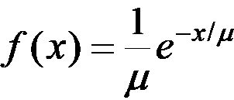
Exponential Probability Distribution
Density Function
f ( x ) = ¹ e^{− x /μ}
μ
where:
μ = mean
e = 2.71828

Slide 35

Exponential Probability Distribution
Suppose that x represents the loading time for a truck at loading dock and follows such a distribution.
If the mean, or average, loading time is 15 minutes ( μ = 15), the appropriate probability density function for x is

Slide 36
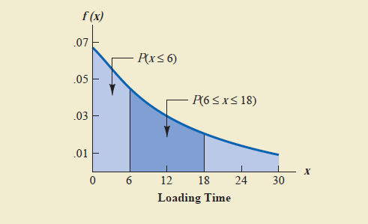
Exponential Distribution for the loading Dock Example

Slide 37
Exponential Probability Distribution Cumulative Probabilities
P(x ≤ x ) = 1− e
− x / μ
o
0
where:
x0 = some specific value of x

Slide 38
Example: Exponential Probability Distribution
The time between arrivals of cars at a Petrol pump follows an exponential
probability distribution with a mean time between arrivals of 3 minutes.
The Petrol pump owner would like to know the probability that the time
between two successive arrivals will be 2 minutes or less.

Slide 39
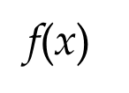
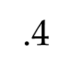
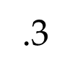
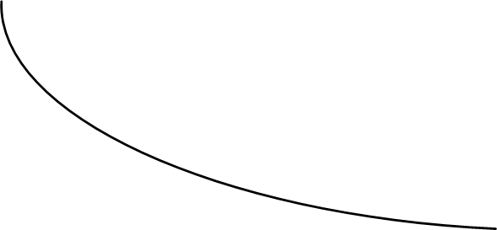

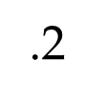
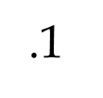

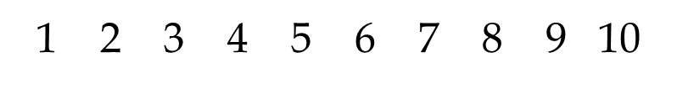
Example: Petrol Pump Problem
f(x)
.4
.3
.2
.1
P(x < 2) = 1 - 2.71828^{-2/3} = 1 - .5134 = 4866
x
1 2 3 4 5 6 7 8 9 10
Time Between Successive Arrivals (mins.)

Slide 40


Relationship between the Poisson and Exponential Distributions
The Poisson distribution
provides an appropriate description of the number of occurrences
per interval
The exponential distribution provides an appropriate description of the length of the interval between occurrences

Slide 41

Mean of Poisson and Mean of Exponential Distributions
Because the average number of arrivals is 10 cars per hour, the average time between cars arriving is

Slide 42
42

Slide 43
The Normal Distribution: Properties
‘Bell Shaped’
Symmetrical
Mean, Median and Mode are equal
Location is characterized by the mean, μ
Spread is characterized by the standard deviation, σ
The random variable has an infinite theoretical range: -∞ to +∞
f(X)
σ
μ
Mean = Median = Mode

Slide 44
The Normal Distribution: Density Function
The formula for the normal probability density function is
1
2πσ
1 ⎛ (X−μ) ⎞²
−
⎜ ⎟
f(X) =
e
2 ⎝ σ
⎠
Where
e = the mathematical constant approximated by 2.71828 π = the mathematical constant approximated by 3.14159 μ = the population mean
σ = the population standard deviation
X = any value of the continuous variable
Chap 6-44

Slide 45
The Normal Distribution: Shape
By varying the parameters μ and σ, we obtain different normal distributions

